Slide 1
A GPU Accelerated Update Efficient Index for kNN Queries in Road Networks
Abstract:
kNN query in road networks is a traditional query type in spatial databases.
new applications：拼车 → 需要高效地返回查询结果
We propose an index structure that uses a “lazy update” strategy to reduce the costs of update handling without sacrificing query efficiency or answer accuracy.
We further propose a kNN query algorithm based on this index, taking advantage of the strengths of both the CPU and the GPU.
首先使用CPU识别查询区域
然后使用GPU处理该区域中的缓存，从而计算备选结果集
最后使用CPU精确计算最终答案
实验证明

Slide 2
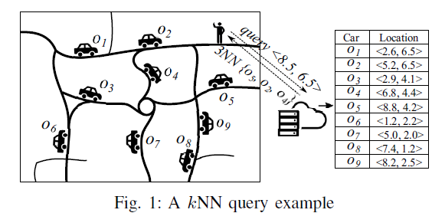
I. INTRODUCTION
kNN query, a basic type of Location-based services (LBS)
We compute the kNN only based on a snapshot(快照) of the locations of the data objects at query time.
An example:
find the three nearest Uber cars for a user
用户处于<8.5, 6.5>，要求找到离他最近的三辆汽车。
服务器检索最近的汽车，比如<o5, o4, o2>，返回给用户。
主要挑战：服务器需要持续获取汽车位置的更新信息，以便在查询处理时使其位置保持最新。

Slide 3
I. INTRODUCTION
Existing techniques:
只针对静态对象的查询不能直接使用
The state-of-the-art road network kNN algorithm V-tree：
可以适用动态对象
优点：用平衡搜索树来索引移动对象和预先打好的表来减少计算成本
不足：每一个位置的更新都会触发索引的更新，因此更新频率高时成本很高
We propose an index structure:
在接收位置更新时简单地缓存位置更新，而不是实际对索引执行更新
在查询时，我们在搜索查询答案之前将缓存的更新刷新到索引中
使用GPU设计高度并行的算法来更新索引，从而确保更高的更新效率
We design a kNN algorithm based on the proposed index:
结合了CPU和GPU的优势
收到查询后，首先使用CPU识别查询区域
然后使用GPU处理该区域中的位置缓存，并使用GPU计算候选结果集
最后使用CPU计算最终答案

Slide 4
I. INTRODUCTION
In summary, we make the following contributions:
We propose a novel index structure and an index updating algorithm that caches and delays index updates until the indexed entries to be updated are queried, to reduce the index update frequency.
We propose a highly parallel algorithm on the GPU for cleaning cached updates simultaneously. The algorithm adopts a low-cost shuffle strategy to solve the synchronization issues and achieve a high concurrency.
We propose a CPU-GPU collaborating kNN query processing algorithm.
We perform cost analysis and extensive experiments. The results confirm the superiority of the proposed algorithms over the state-of-the-art algorithms.

Slide 5
I. INTRODUCTION
In summary, we make the following contributions:
We propose a novel index structure and an index updating algorithm that caches and delays index updates until the indexed entries to be updated are queried, to reduce the index update frequency.
We propose a highly parallel algorithm on the GPU for cleaning cached updates simultaneously. The algorithm adopts a low-cost shuffle strategy to solve the synchronization issues and achieve a high concurrency.
We propose a CPU-GPU collaborating kNN query processing algorithm.
We perform cost analysis and extensive experiments. The results confirm the superiority of the proposed algorithms over the state-of-the-art algorithms.
the paper is organized as follows:
Section II present preliminaries.
Section III describe the proposed index structure.
Section IV and Section V detail the index update algorithms and the kNN query algorithm.
Section VI and Section VII report cost analysis and experimental results.
Section VIII review related studies.
Section IX conclude the paper.

Slide 6
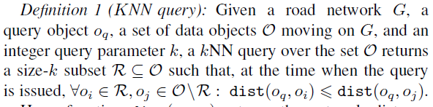

II. PRELIMINARIES
使用有向图$G=<V, E>$来表示路网
We assume a static query object $o_{q}$ and a set of n data objects O = {$o_{1}$, $o_{2}$, … , $o_{n}$}
Definition 1 (KNN query):

Slide 7
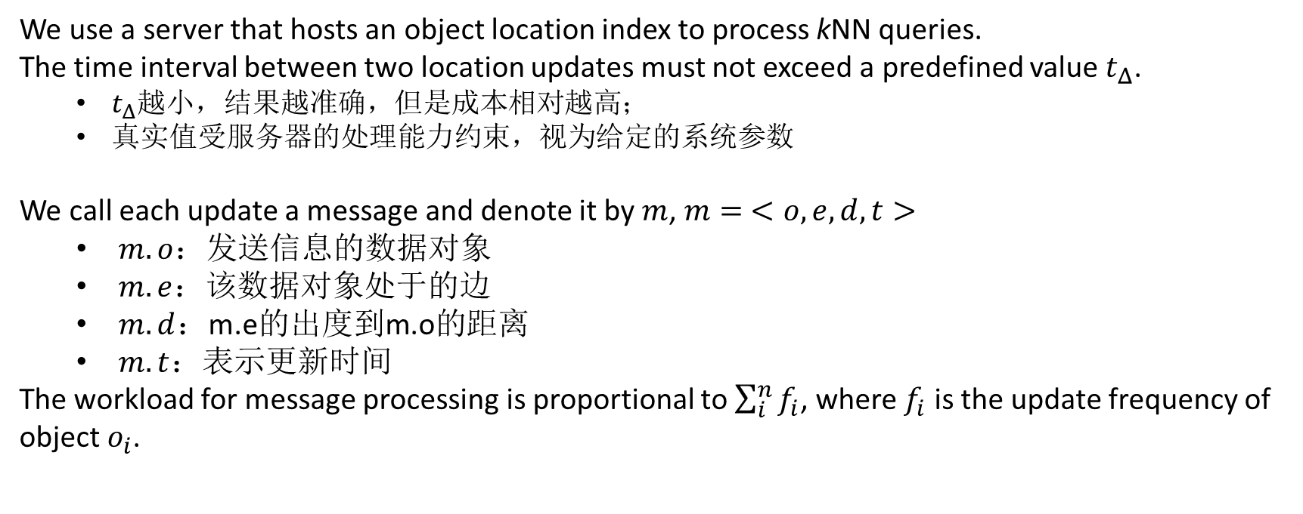
II. PRELIMINARIES
We use a server that hosts an object location index to process kNN queries.
The time interval between two location updates must not exceed a predefined value $t_{Δ}$.
$t_{Δ}$越小，结果越准确，但是成本相对越高；
真实值受服务器的处理能力约束，视为给定的系统参数
We call each update a message and denote it by $m$, $m= <o, e, d, t>$
$m.o$：发送信息的数据对象
$m.e$：该数据对象处于的边
$m.d$：m.e的出度到m.o的距离
$m.t$：表示更新时间
The workload for message processing is proportional to $\sum_{i}^{n}{f_{i}}$, where $f_{i}$ is the update frequency of object $o_{i}$.

Slide 8
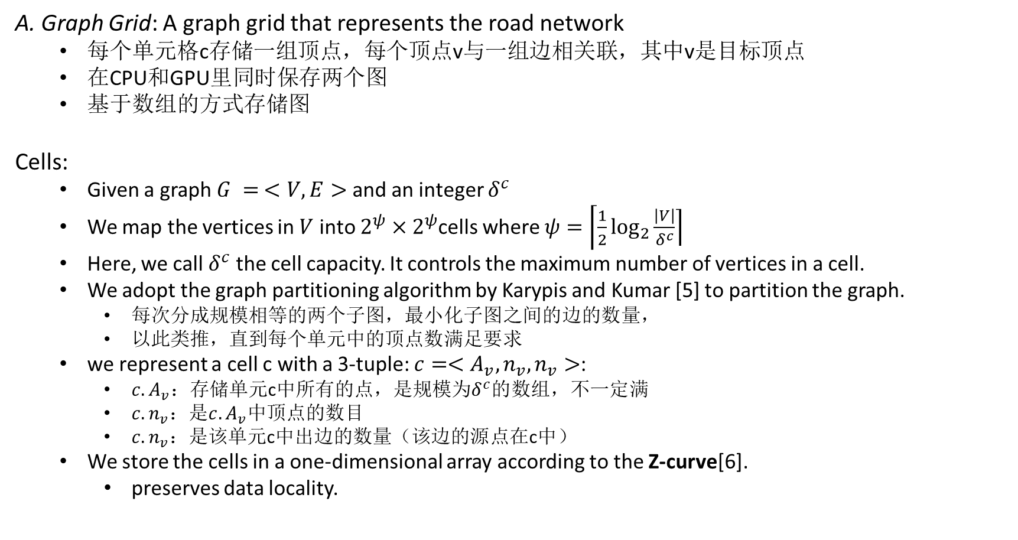
III. G-GRID INDEX
A. Graph Grid: A graph grid that represents the road network
每个单元格c存储一组顶点，每个顶点v与一组边相关联，其中v是目标顶点
在CPU和GPU里同时保存两个图
基于数组的方式存储图
Cells:
Given a graph $G = <V,E>$and an integer $δ^{c}$
We map the vertices in $V$ into $2^{ψ}×2^{ψ}$cells where $ψ=\left\lceil \frac{1}{2}\right.\left.\log_{2}{\frac{\left|V\right|}{δ^{c}}}\right\rceil$
Here, we call $δ^{c}$ the cell capacity. It controls the maximum number of vertices in a cell.
We adopt the graph partitioning algorithm by Karypis and Kumar [5] to partition the graph.
每次分成规模相等的两个子图，最小化子图之间的边的数量，
以此类推，直到每个单元中的顶点数满足要求
we represent a cell c with a 3-tuple: $c=<A_{v}, n_{v},n_{v}>$:
$c. A_{v}$：存储单元c中所有的点，是规模为$δ^{c}$的数组，不一定满
$c. n_{v}$：是$c. A_{v}$中顶点的数目
$c. n_{v}$：是该单元c中出边的数量（该边的源点在c中）
We store the cells in a one-dimensional array according to the Z-curve[6].
preserves data locality.

Slide 9
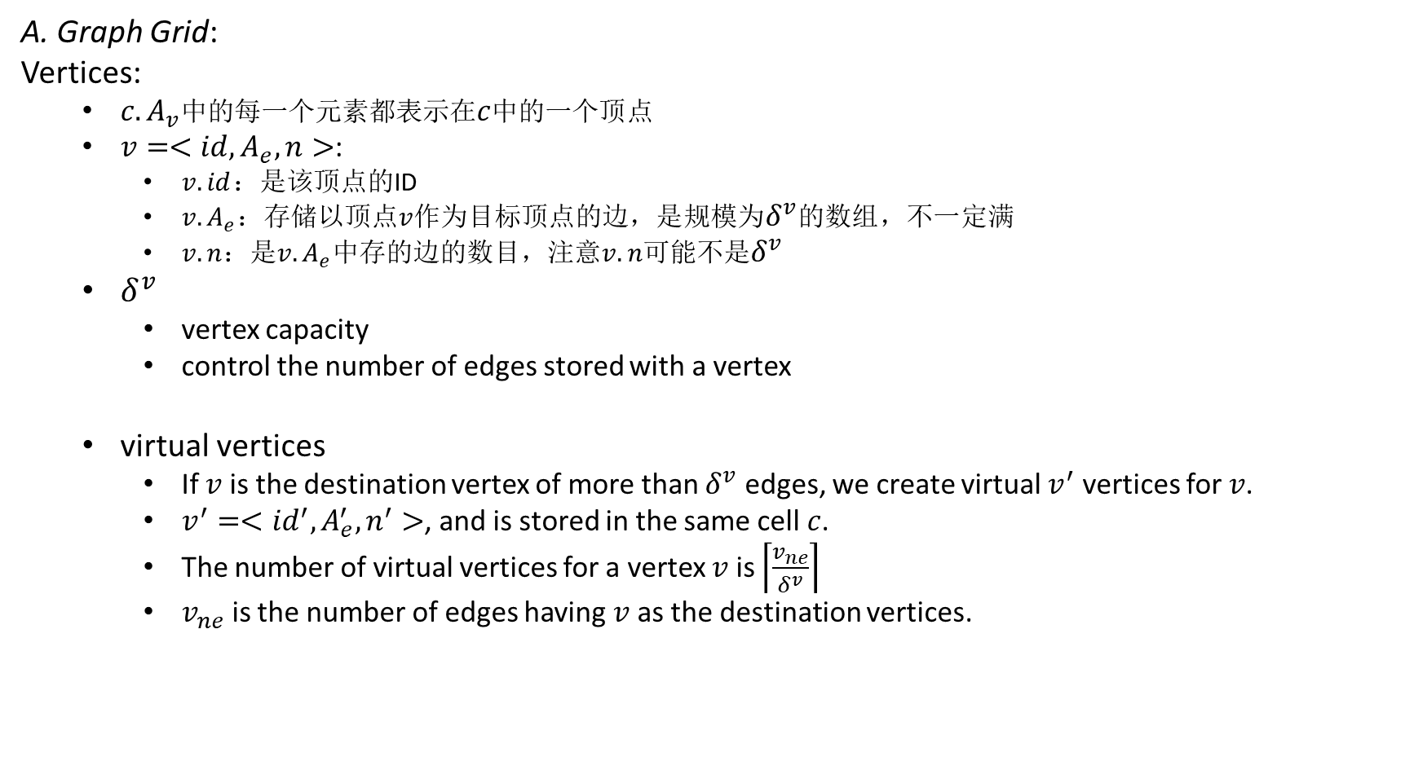
III. G-GRID INDEX
A. Graph Grid:
Vertices:
$c. A_{v}$中的每一个元素都表示在$c$中的一个顶点
$v=<id,A_{e}, n>$:
$v.id$：是该顶点的ID
$v. A_{e}$：存储以顶点$v$作为目标顶点的边，是规模为$δ^{v}$的数组，不一定满
$v.n$：是$v. A_{e}$中存的边的数目，注意$v.n$可能不是$δ^{v}$
$δ^{v}$
vertex capacity
control the number of edges stored with a vertex
virtual vertices
If $v$ is the destination vertex of more than $δ^{v}$ edges, we create virtual $v^{′}$ vertices for $v$.
$v^{′}=<{id}^{′},A_{e}^{′}, n^{′}>$, and is stored in the same cell $c$.
The number of virtual vertices for a vertex $v$ is $\left\lceil \left.\frac{v_{ne}}{δ^{v}}\right\rceil \right.$
$v_{ne}$ is the number of edges having $v$ as the destination vertices.

Slide 10
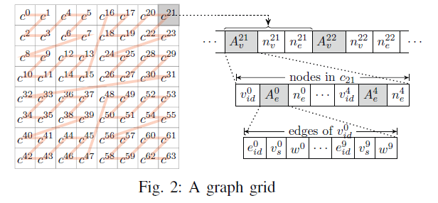
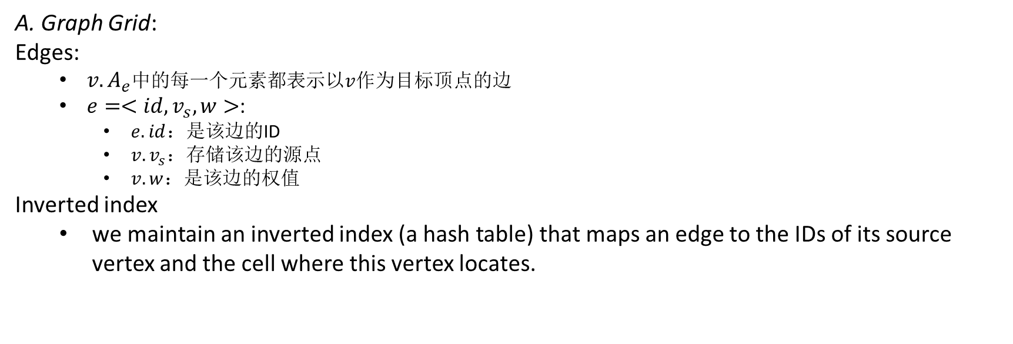
III. G-GRID INDEX
A. Graph Grid:
Edges:
$v. A_{e}$中的每一个元素都表示以$v$作为目标顶点的边
$e=<id,v_{s}, w>$:
$e.id$：是该边的ID
$v. v_{s}$：存储该边的源点
$v.w$：是该边的权值
Inverted index
we maintain an inverted index (a hash table) that maps an edge to the IDs of its source vertex and the cell where this vertex locates.

Slide 11
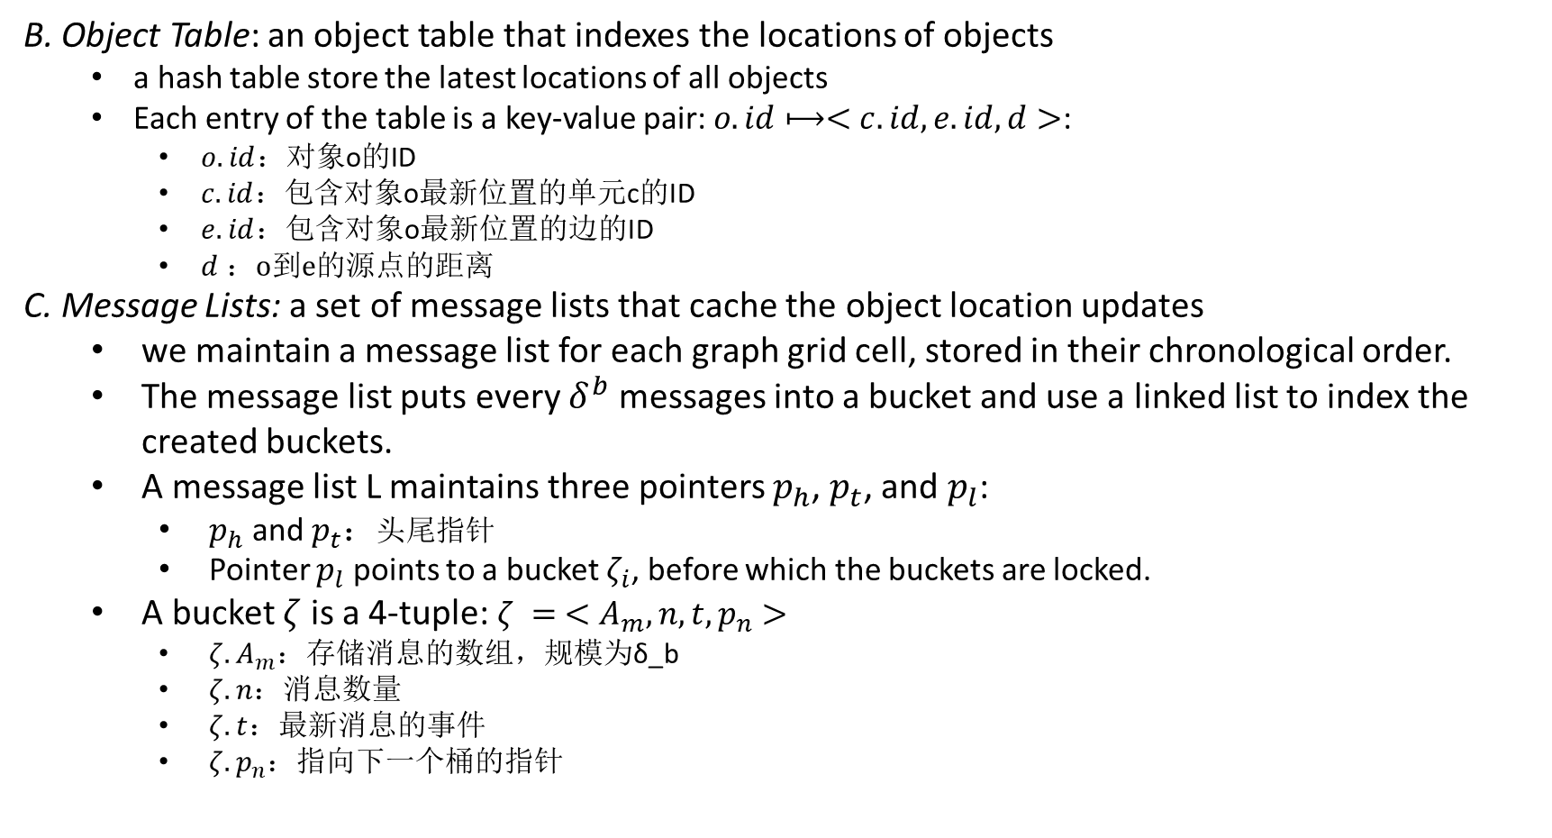
III. G-GRID INDEX
B. Object Table: an object table that indexes the locations of objects
a hash table store the latest locations of all objects
Each entry of the table is a key-value pair: $o.id⟼<c.id,e.id,d>$:
$o.id$：对象o的ID
$c.id$：包含对象o最新位置的单元c的ID
$e.id$：包含对象o最新位置的边的ID
$d$：o到e的源点的距离
C. Message Lists: a set of message lists that cache the object location updates
we maintain a message list for each graph grid cell, stored in their chronological order.
The message list puts every $δ^{b}$ messages into a bucket and use a linked list to index the created buckets.
A message list L maintains three pointers $p_{h}$, $p_{t}$, and $p_{l}$:
$p_{h}$ and $p_{t}$：头尾指针
Pointer $p_{l}$ points to a bucket $ζ_{i}$, before which the buckets are locked.
A bucket $ζ$ is a 4-tuple: $ζ = <A_{m}, n, t, p_{n}>$
$ζ. A_{m}$：存储消息的数组，规模为δ_b
$ζ.n$：消息数量
$ζ.t$：最新消息的事件
$ζ. p_{n}$：指向下一个桶的指针

Slide 12
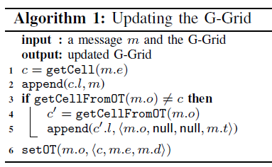
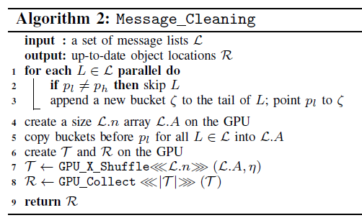
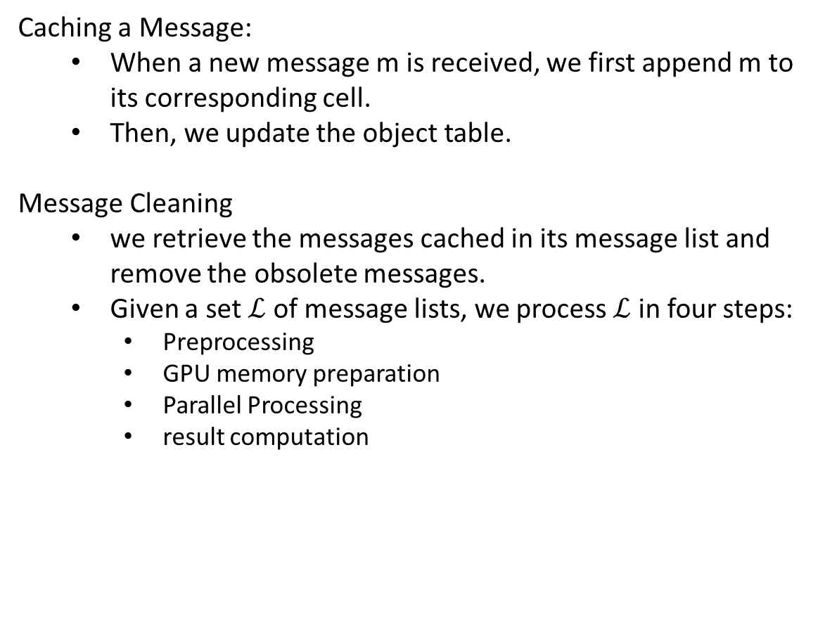
IV. UPDATING THE G-GRID
Caching a Message:
When a new message m is received, we first append m to its corresponding cell.
Then, we update the object table.
Message Cleaning
we retrieve the messages cached in its message list and remove the obsolete messages.
Given a set $ℒ$ of message lists, we process $ℒ$ in four steps:
Preprocessing
GPU memory preparation
Parallel Processing
result computation

Slide 13
IV. UPDATING THE G-GRID
Caching a Message:
When a new message m is received, we first append m to its corresponding cell.
Then, we update the object table.
Message Cleaning
we retrieve the messages cached in its message list and remove the obsolete messages.
Given a set $ℒ$ of message lists, we process $ℒ$ in four steps:
Preprocessing
GPU memory preparation
Parallel Processing
result computation

Slide 14
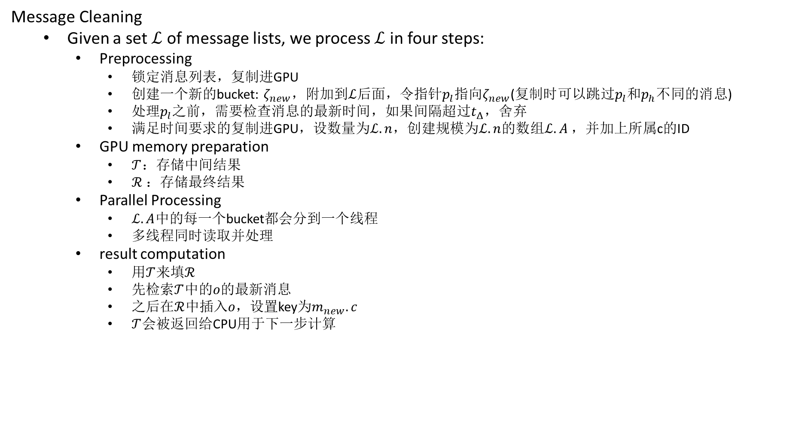
IV. UPDATING THE G-GRID
Message Cleaning
Given a set $ℒ$ of message lists, we process $ℒ$ in four steps:
Preprocessing
锁定消息列表，复制进GPU
创建一个新的bucket: $ζ_{new}$，附加到$ℒ$后面，令指针$p_{l}$指向$ζ_{new}$(复制时可以跳过$p_{l}$和$p_{h}$不同的消息)
处理$p_{l}$之前，需要检查消息的最新时间，如果间隔超过$t_{Δ}$，舍弃
满足时间要求的复制进GPU，设数量为$ℒ.n$，创建规模为$ℒ.n$的数组$ℒ.A$，并加上所属c的ID
GPU memory preparation
$𝒯$：存储中间结果
$ℛ$：存储最终结果
Parallel Processing
$ℒ.A$中的每一个bucket都会分到一个线程
多线程同时读取并处理
result computation
用$𝒯$来填$ℛ$
先检索$𝒯$中的$o$的最新消息
之后在$ℛ$中插入$o$，设置key为$m_{new}.c$
$𝒯$会被返回给CPU用于下一步计算

Slide 15
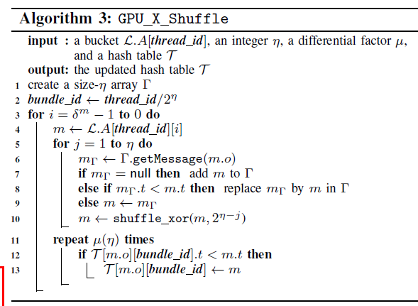
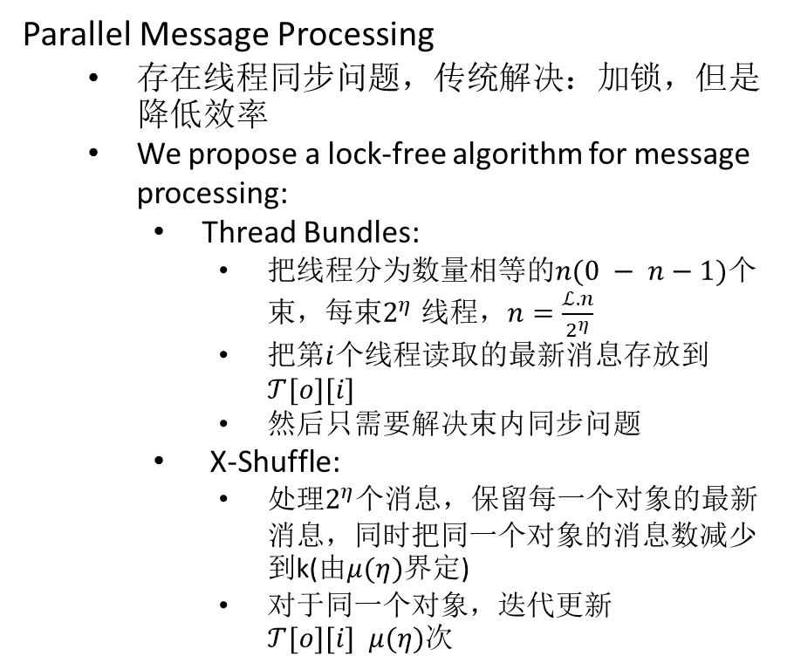
IV. UPDATING THE G-GRID
Parallel Message Processing
存在线程同步问题，传统解决：加锁，但是降低效率
We propose a lock-free algorithm for message processing:
Thread Bundles:
把线程分为数量相等的$n(0 − n−1)$个束，每束$2^{η}$ 线程，$n=\frac{ℒ.n}{2^{η}}$
把第$i$个线程读取的最新消息存放到$𝒯[o][i]$
然后只需要解决束内同步问题
X-Shuffle:
处理$2^{η}$个消息，保留每一个对象的最新消息，同时把同一个对象的消息数减少到k(由$μ(η)$界定)
对于同一个对象，迭代更新$𝒯[o][i] μ(η)$次

Slide 16
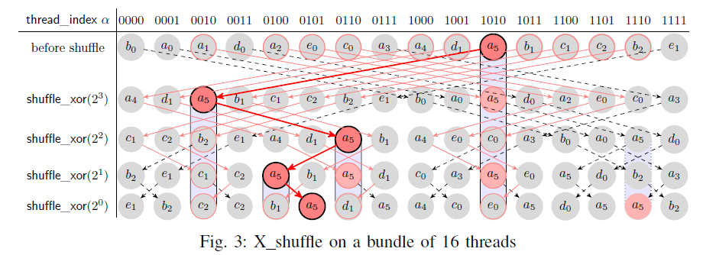

IV. UPDATING THE G-GRID
Parallel Message Processing
G_X_Shuffle的图示
$η = 4$
$μ(η) = μ(4) = 2$

Slide 17
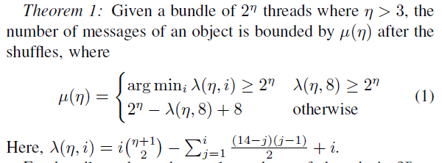
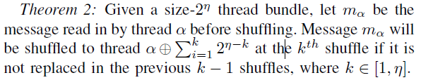
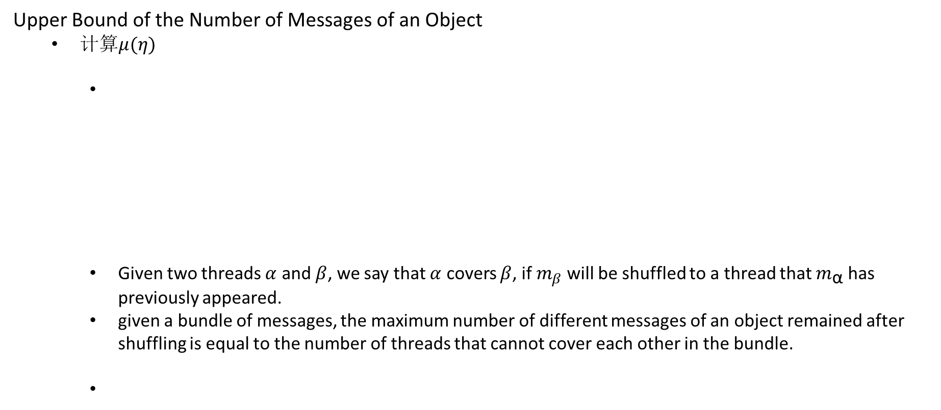
IV. UPDATING THE G-GRID
Upper Bound of the Number of Messages of an Object
计算$μ(η)$
Given two threads $α$ and $β$, we say that $α$ covers $β$, if $m_{β}$ will be shuffled to a thread that $m_{\text{α}}$ has previously appeared.
given a bundle of messages, the maximum number of different messages of an object remained after shuffling is equal to the number of threads that cannot cover each other in the bundle.

Slide 18


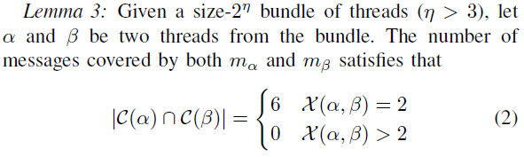
IV. UPDATING THE G-GRID
Upper Bound of the Number of Messages of an Object
证明定理1
一个定义
5个引理

Slide 19
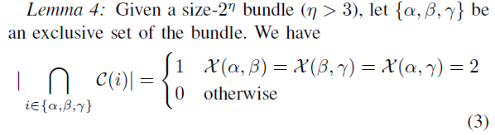
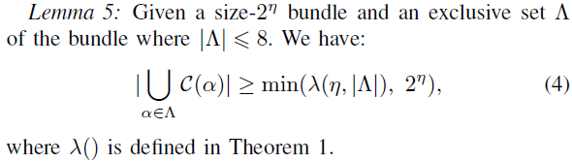
IV. UPDATING THE G-GRID
Upper Bound of the Number of Messages of an Object
证明定理1
5个引理

Slide 20
IV. UPDATING THE G-GRID
Upper Bound of the Number of Messages of an Object
证明定理1
5个引理

Slide 21
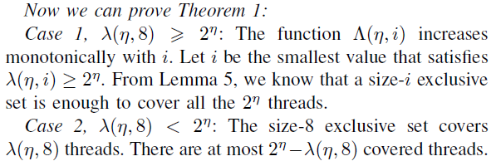
IV. UPDATING THE G-GRID
Upper Bound of the Number of Messages of an Object
证明定理1

Slide 22
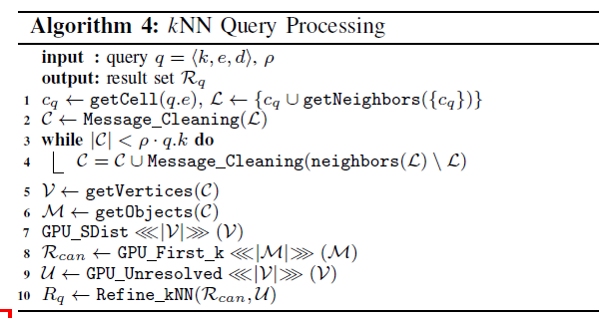
V. kNN QUERY PROCESSING
We present our kNN algorithm in Algorithm 4:
three steps
确定结果所在单元并发送消息到GPU进行消息清理
构造候选集
细化候选集获得最终结果

Slide 23
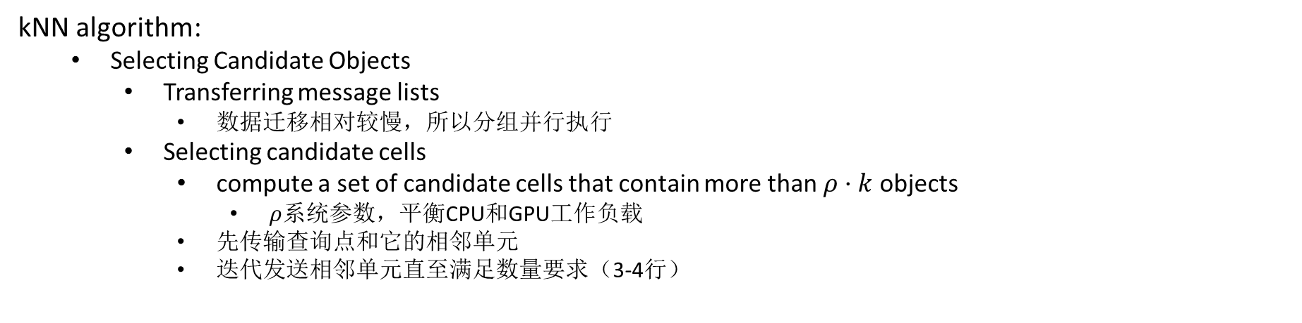
V. kNN QUERY PROCESSING
kNN algorithm:
Selecting Candidate Objects
Transferring message lists
数据迁移相对较慢，所以分组并行执行
Selecting candidate cells
compute a set of candidate cells that contain more than $ρ·k$ objects
$ρ$系统参数，平衡CPU和GPU工作负载
先传输查询点和它的相邻单元
迭代发送相邻单元直至满足数量要求（3-4行）

Slide 24
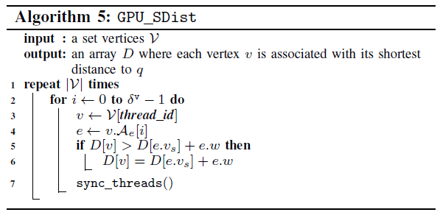
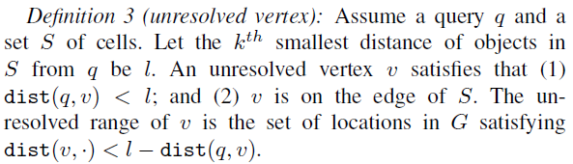

V. kNN QUERY PROCESSING
kNN algorithm:
Constructing a Candidate Result Set
Computing candidate objects $𝒱$ :
计算备选单元集中的每一个顶点到q的最短路径。
使用bell-ford算法的变体，并行处理目标顶点不同的边
Computing unresolved vertices $ℳ$ :

Slide 25
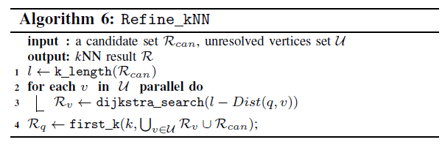
V. kNN QUERY PROCESSING
kNN algorithm:
Final Result Refinement
使用dijkstra算法
由CPU最终完成

Slide 26
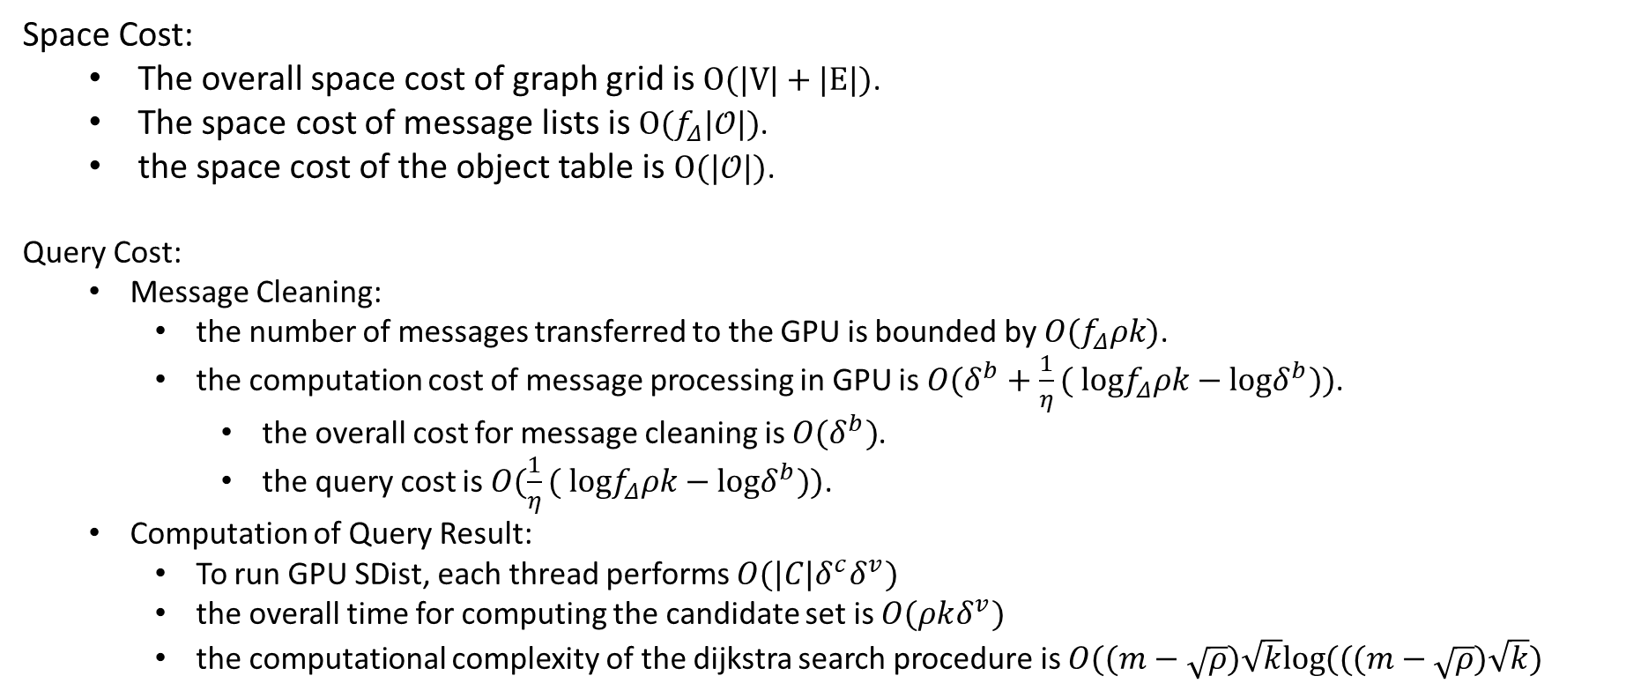
VI. COST ANALYSIS
Space Cost:
The overall space cost of graph grid is $O(|V|+|E|)$.
The space cost of message lists is $O(f_{Δ}|𝒪|)$.
the space cost of the object table is $O(|𝒪|)$.
Query Cost:
Message Cleaning:
the number of messages transferred to the GPU is bounded by $O(f_{Δ}ρk)$.
the computation cost of message processing in GPU is $O(δ^{b}+\frac{1}{η}( logf_{Δ}ρk−logδ^{b}))$.
the overall cost for message cleaning is $O(δ^{b})$.
the query cost is $O(\frac{1}{η}( logf_{Δ}ρk−logδ^{b}))\text{.}$
Computation of Query Result:
To run GPU SDist, each thread performs $O(|C|δ^{c}δ^{v})$
the overall time for computing the candidate set is $O(ρkδ^{v})$
the computational complexity of the dijkstra search procedure is $O((m−\sqrt{ρ})\sqrt{k}log⁡(((m−\sqrt{ρ})\sqrt{k})$

Slide 27
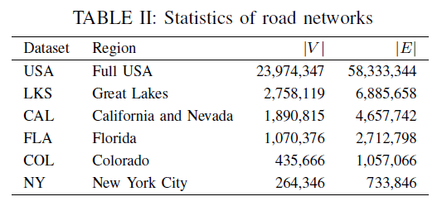
VII. EXPERIMENTAL STUDY
Settings:
C++ and CUDA 9.0.
Windows operating system
16GB memory
two 2.5 GHz Intel Xeon E5 CPUs (12 physical cores in total)
Nvidia Quadro P2000 GPU with 1024 cores and 5GB memory
six real-world road networks
We generate the moving objects using MOTO
randomly generate the query locations

Slide 28
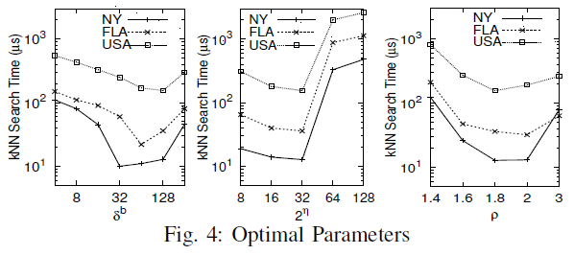
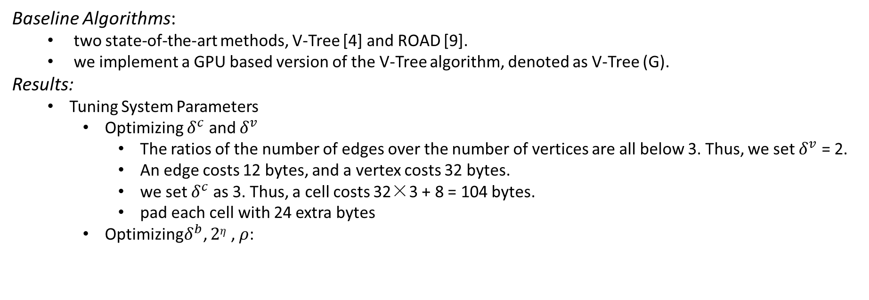
VII. EXPERIMENTAL STUDY
Baseline Algorithms:
two state-of-the-art methods, V-Tree [4] and ROAD [9].
we implement a GPU based version of the V-Tree algorithm, denoted as V-Tree (G).
Results:
Tuning System Parameters
Optimizing $δ^{c}$ and $δ^{v}$
The ratios of the number of edges over the number of vertices are all below 3. Thus, we set $δ^{v}$ = 2.
An edge costs 12 bytes, and a vertex costs 32 bytes.
we set $δ^{c}$ as 3. Thus, a cell costs 32×3 + 8 = 104 bytes.
pad each cell with 24 extra bytes
Optimizing$δ^{b}$, $2η$ , $ρ$:

Slide 29
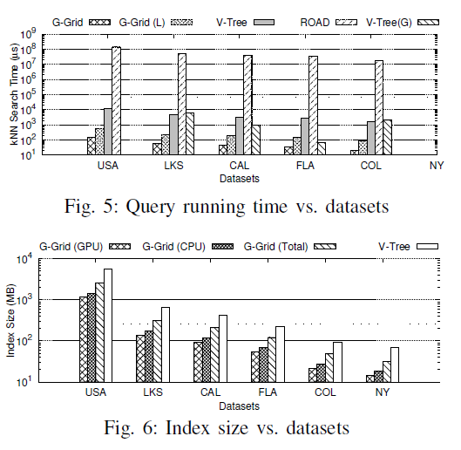
VII. EXPERIMENTAL STUDY
Results:
Comparing with Baseline Algorithms:
Varying datasets.

Slide 30
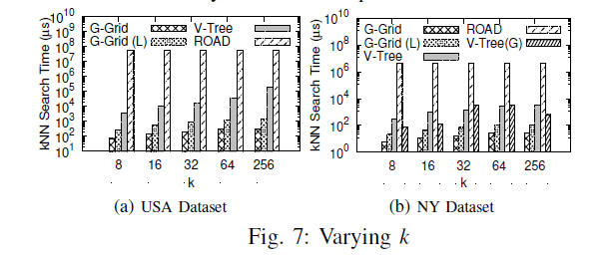
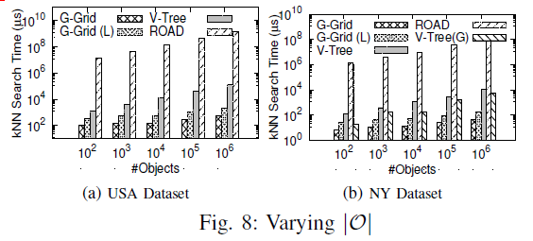
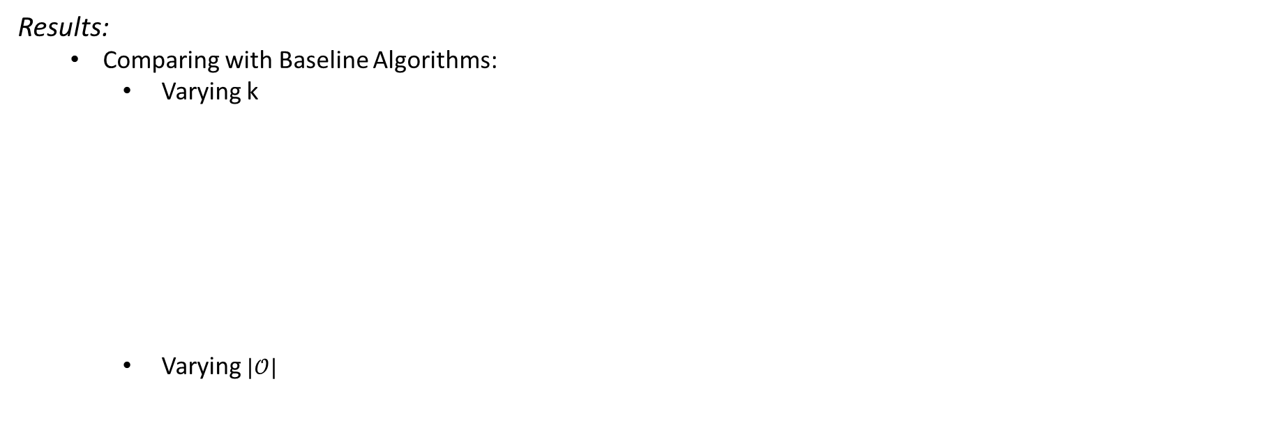
VII. EXPERIMENTAL STUDY
Results:
Comparing with Baseline Algorithms:
Varying k
Varying $|𝒪|$

Slide 31
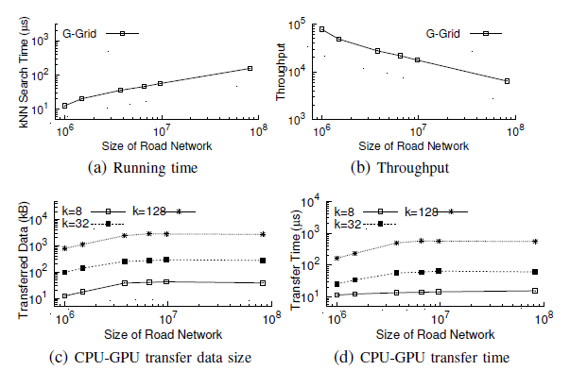
VII. EXPERIMENTAL STUDY
Results:
Scalability of G-Grid:
Running time and throughput
DRAM-GPU transfer costs
Notes:
可扩展性

Slide 32
VIII. RELATED WORK
We review two most relevant groups of kNN studies:
kNN queries in road networks
Kolahdouzan and Shahabi [13] precompute Voronoi cells over a road network.
Huang et al. [14] propose a model for the abstract functionality of a road network NN search.
Papadias et al. [15] utilize the Euclidean distance to facilitate NN search in road networks.
A few other studies [16], [17], [18] consider monitoring a kNN query continuously as the objects are moving.
这些研究重点是降低处理与同一查询相关的更新成本，而我们是降低所有数据对象的更新成本
kNN queries using GPUs.
GPUs have been used to accelerate kNN query processing [19], [20].
A fine-tuned linear algebra library CUBLAS [21] is utilized in these studies to compute the distances between objects.
Another GPU-based kNN algorithm [22] speeds up kNN computation for a set of queries using shared computation.
This algorithm does not focus on handling object location updates.
Notes:
Kolahdouzan和Shahabi [13]在道路网络上预先计算了Voronoi单元，然后可以通过先识别查询对象所在的Voronoi单元，在将搜索扩展到相邻的Voronoi单元来处理kNN查询。
黄等人 [14]提出了一个道路网NN搜索的抽象功能模型，提出了一种类似于Dijkstra算法的算法来计算数据对象之间的距离，以帮助在线识别NN。
Papadias等[15]利用欧几里德距离来促进道路网络中的NN搜索。
其他一些研究[16]，[17]，[18]考虑在物体移动时连续监测kNN查询。重点是降低处理与同一查询相关的更新成本，而不像我们一样降低所有数据对象的更新成本。
GPU已被用于加速kNN查询[19]，[20]。在这些研究中使用微调线性代数库CUBLAS [21]来计算物体之间的距离。
另一种基于GPU的kNN算法[22]使用共享计算来加速一组kNN查询的计算。该算法不专注于处理对象位置更新。

Slide 33
VIII. RELATED WORK
Indexing and querying moving objects:
The cover field tree [23] is proposed to speed up moving object indexing by controlling the size of each cells in the index.
Sidlauskas et al. [24] point out that for update-intensive workloads such as indexing moving objects, grid-based structures outperforms tree-based structures.
Darius et al. [7] propose the PGrid, which is a main memory index that exploits parallelism of modern multi-core processors to support both long-running queries and rapid updates in Euclidean space.
Their work differs from ours in three aspects.
First, they focus on kNN queries in Euclidean space rather than road networks.
Second, they improve the update efficiency through accelerating every update but not delaying or skipping any updates.
Third, they achieve parallel processing using a multi-core CPU while we use the GPU, which allows much more threads but also brings challenges in concurrency control.
Notes:
Darius等人[7]提出了PGrid，一个主存索引，利用现代多核处理器的并行性来支持欧几里德空间的长期运行的查询和快速更新。
他们的工作在三个方面与我们的不同。1. 他们专注于欧几里德空间而不是道路网络中的kNN查询。2. 他们通过加速每次更新而不是延迟或跳过任何更新来提高更新效率。3. 他们使用多核CPU实现并行处理，而不是GPU，GPU有更多的线程，但也带来了并发控制的挑战。

Slide 34
IX. CONCLUSION
We studied the kNN query in road networks with data location updates.
We presented an indexing method that avoids unnecessary index updates via a lazy update strategy.
In particular, we proposed a highly parallel algorithm for efficient handling of cached updates, which enables the lazy update strategy.
We further proposed a GPU-CPU collaborating algorithm for kNN query processing based on our indexing method.
The experimental results show that the proposed algorithm outperforms the state-of-the-art algorithms in both query time and index size.
Notes:
总结：
我们研究了具有数据位置更新的道路网络中的kNN查询，提出了一种索引方法，通过延迟更新策略避免不必要的索引更新。 特别地，我们提出了一种高度并行的算法，用于有效处理缓存更新，从而实现延迟更新策略。
我们进一步提出了一种GPU-CPU协作算法，可以对于基于我们的索引方法kNN查询处理。实验结果表明，该算法在查询时间和索引大小方面均优于最先进的算法。

Slide 35
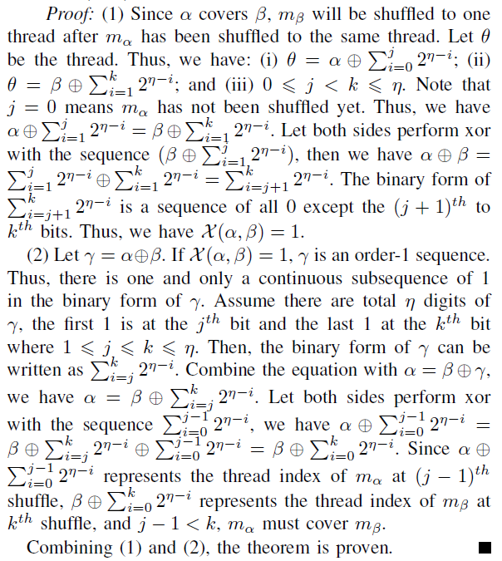
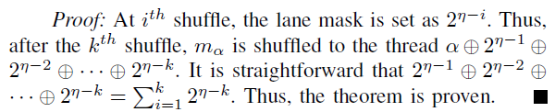
Certification

Slide 36
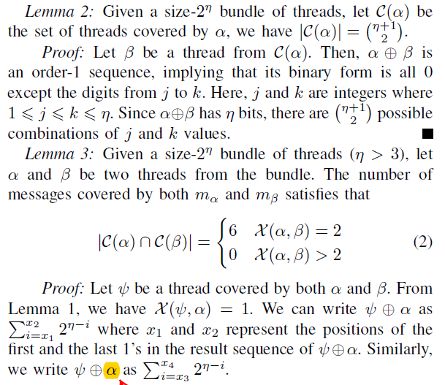
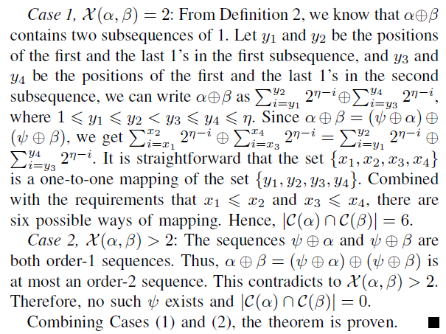
Certification

Slide 37
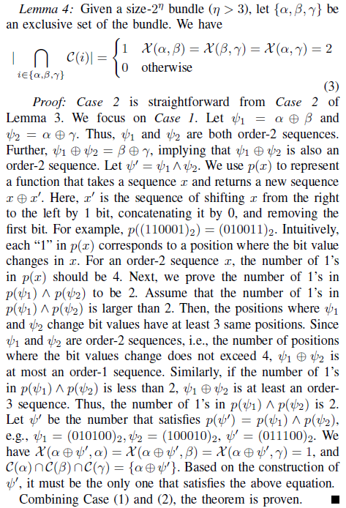
Certification

Slide 38
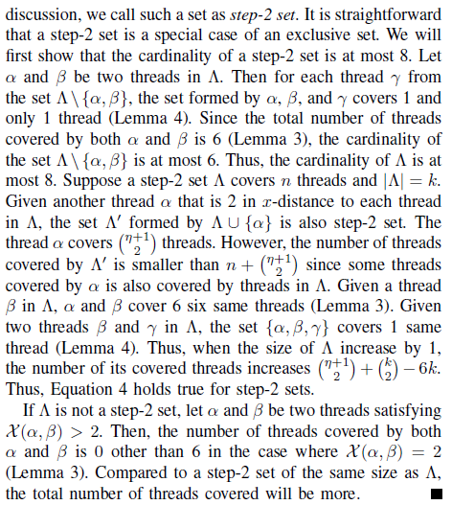
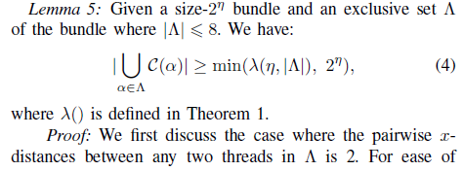
Certification

